Slide 1
Implementation inheritance
CREATING ABSTRACT CLASSES AND METHODS
OVERLOADING AND OVERRIDING

Slide 2
Inheritance in VB.NET
Often, types in a program share the same characteristics. For example, a program may contain types that represent a customer and an employee.

Slide 3
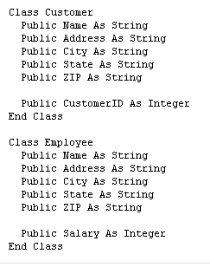

Slide 4
In this situation, both the Customer and Employee classes contain a number of identical fields. This is because the two classes each describe a person, and a person has certain characteristics, such as a name and address, that exist independent of whether or not they are a customer or an employee.
This commonality between the Customer type and the Employee type can be expressed through inheritance. Instead of repeating the same information in both types, you can create a class called Person that contains the common characteristics of a person.

Slide 5
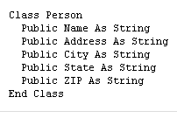

Slide 6
The class Person represents all the characteristics of a person that exist independent of whether the person is a customer or an employee. Once the Person class is defined, the Customer and Employee classes can inherit all the members of the Person class. This means that the classes have to define only the members that are unique to each class.

Slide 7
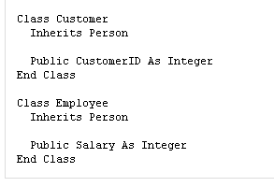

Slide 8
When one class inherits members from another class, the inheriting class derives from the other type. The type being derived from is called the base type. A type inherits all the members that the base type defines, including methods and events. So the Employee and Customer classes still have fields named Name, Address, City, State, ZIP, and Phone, even though they don't explicitly declare them, because they inherit them from Person. For example, the classes can be used as follows.

Slide 9
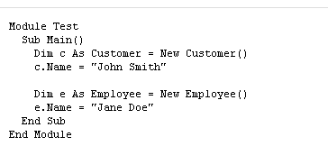

Slide 10
A class that derives from another class can in turn be derived from by another class. For example, Employee can be further specialized by classes such as Manager and Programmer.

Slide 11
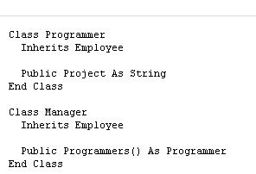

Slide 12
Conversions
When a class derives from another class, it automatically inherits all the members of the base class. As a result, a derived class can always be safely converted to one of its base classes. For example:

Slide 13
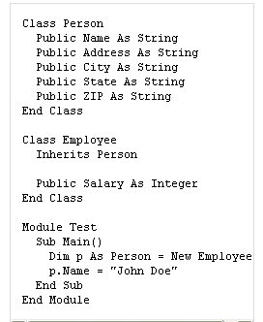

Slide 14
Different Types of Inheritance
Inheritance is the process of creating a new Class, called the Derived Class, from the existing class, called the Base Class. The Inheritance has many advantages, the most important of them being the reusability of code. Rather than developing new Objects from scratch, new code can be based on the work of other developers, adding only the new features that are needed. The reuse of existing classes saves time and effort.
However, inheritance may be implemented in different combinations in Object-Oriented

Slide 15
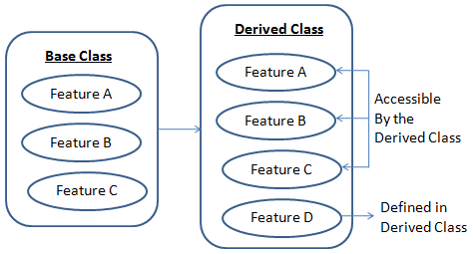
Programming languages as illustrated in figure and they include:

Slide 16
Single Inheritance
Multi Level Inheritance
Hierarchical Inheritance
Hybrid Inheritance
Multipath inheritance
Multiple Inheritance

Slide 17
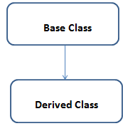
Single Inheritance
When a Derived Class to inherit properties and behavior from a single Base Class, it is called as single inheritance.

Slide 18
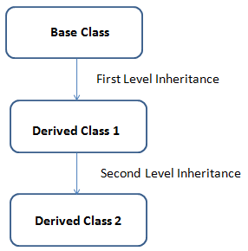
Multi Level Inheritance
A derived class is created from another derived class is called Multi Level Inheritance

Slide 19
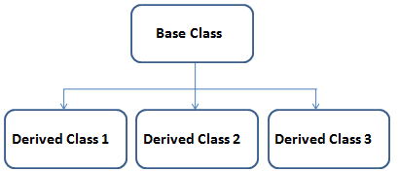
Hierarchical Inheritance
More than one derived class are created from a single base class, is called Hierarchical Inheritance

Slide 20
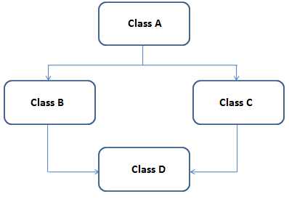
Hybrid Inheritance
Any combination of above three inheritance (single, hierarchical and multi level) is called as hybrid inheritance.

Slide 21
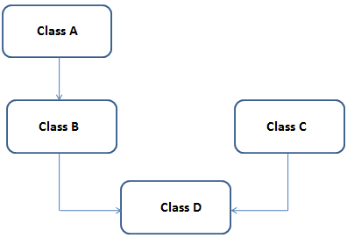
Multipath inheritance
Multiple inheritance is a method of inheritance in which one derived class can inherit properties of base class in different paths. This inheritance is not supported in .NET Languages such as C#.

Slide 22
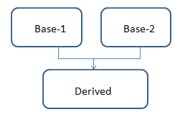
Multiple Inheritance
Multiple inheritances allows programmers to create classes that combine aspects of multiple classes and their corresponding hierarchies. In .Net Framework, the classes are only allowed to inherit from a single parent class, which is called single inheritance.

Slide 23
Overriding
Defining an inheritance hierarchy is all about defining the types in a system from most general to most specific. With inheritance, however, a derived type can only add new members to those it inherits from its base type. Sometimes, though, a derived type may want to change the behavior of members that it inherits from a base type. For example, the base class Person may define a Print method that prints information about the class.

Slide 24
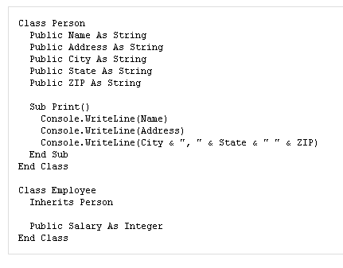

Slide 25
In this example, though, calling the method Employee.Print will only print the name and address of an employee, not the employee's salary. There is no way, using inheritance, to change the inherited implementation of Person.Print.
Changing the implementation of derived methods is possible, however, through overriding. A base class can declare that a particular method or methods are Overridable, which means that a derived class can replace the implementation that the base class provides. For example:

Slide 26
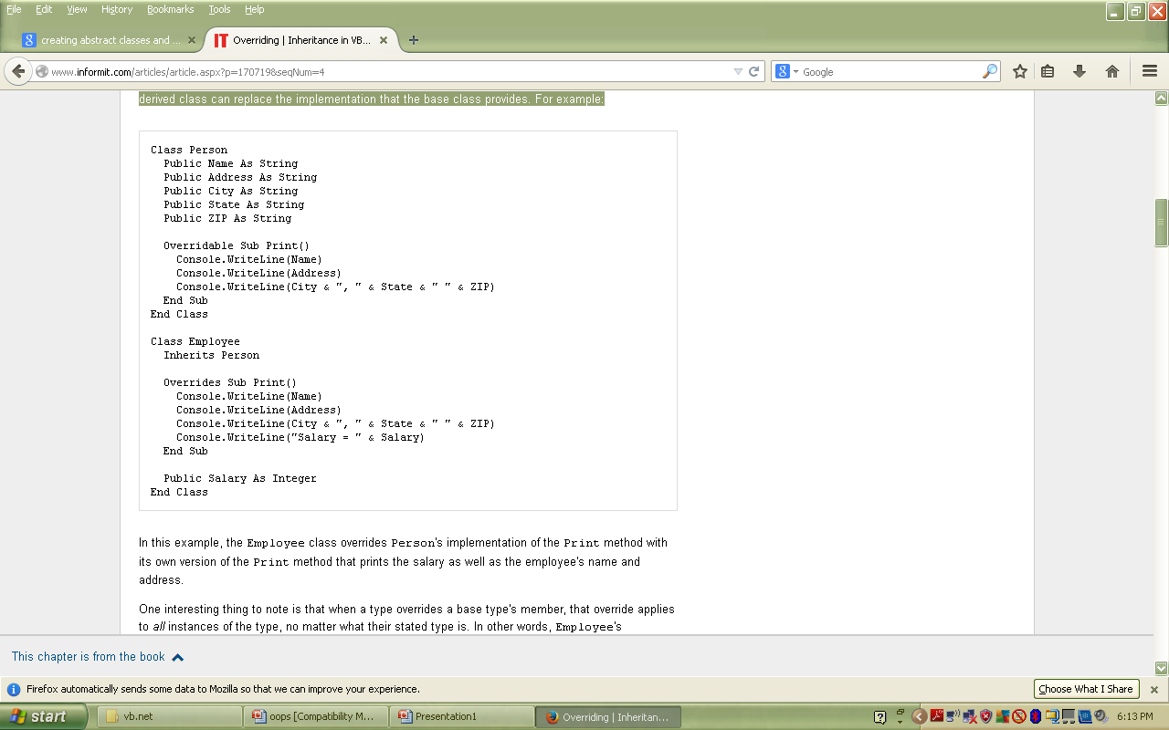

Slide 27
In this example, the Employee class overrides Person's implementation of the Print method with its own version of the Print method that prints the salary as well as the employee's name and address.
One interesting thing to note is that when a type overrides a base type's member, that override applies to all instances of the type, no matter what their stated type is. In other words, Employee's implementation of Print is the one that will be called on an Employee instance, even if it is typed as a Person. The following example:

Slide 28
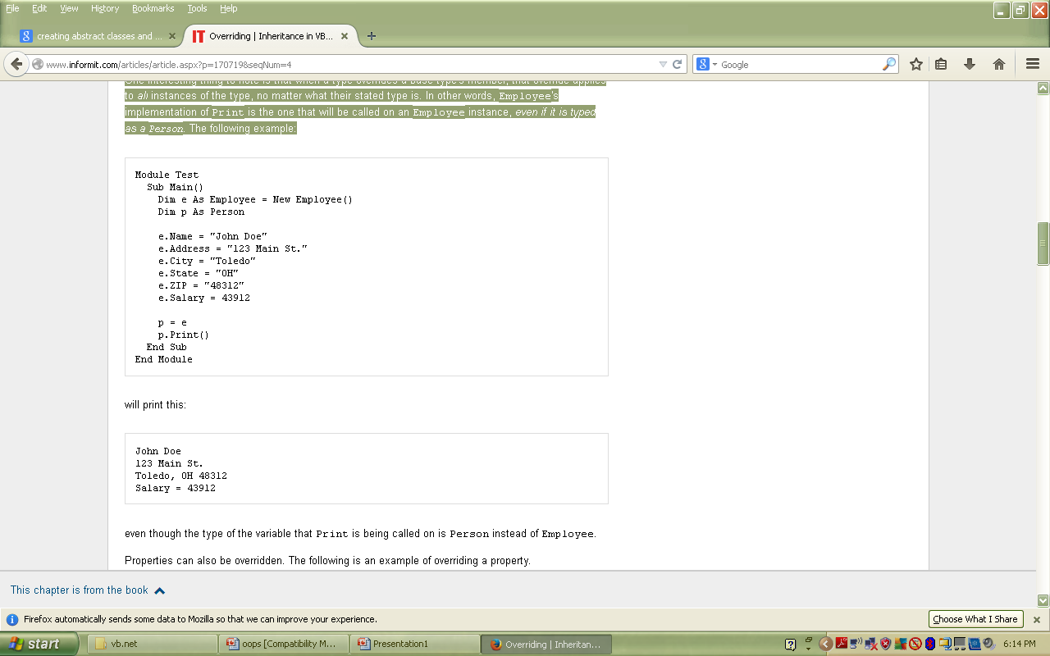

Slide 29
even though the type of the variable that Print is being called on is Person instead of Employee.
Properties can also be overridden. The following is an example of overriding a property.

Slide 30
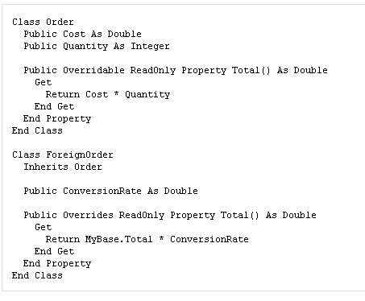

Slide 31
Over loading VB.NET
Overloading in visual basic.net is the method by which a property or a method takes different forms at different instances. It can also be termed as "Polymorphism".
BY LECTURER SURAJ PANDEY CCT COLLEGE

Slide 32
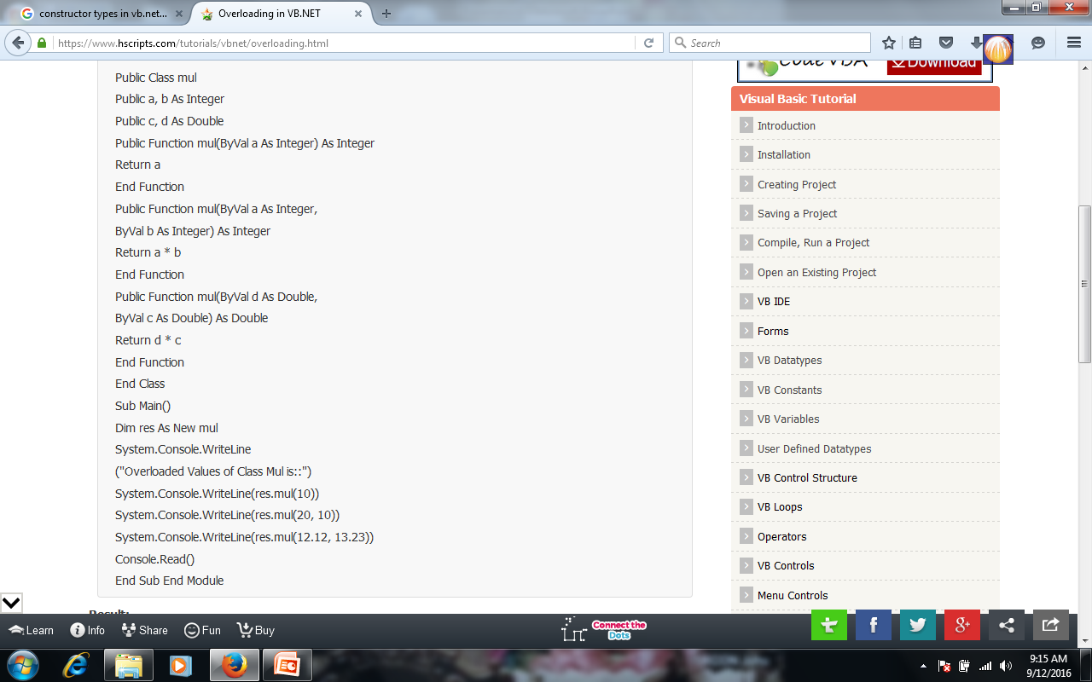
BY LECTURER SURAJ PANDEY CCT COLLEGE

Slide 33
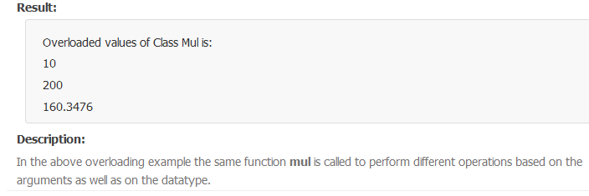
BY LECTURER SURAJ PANDEY CCT COLLEGE

Slide 34
Over riding in VB.NET
Overriding in VB.net is method by which a inherited property or a method is overidden to perform a different functionality in a derived class. The base class function is declared using a keyword Overridable and the derived class function where the functionality is changed contains an keyword Overrides.
Example:
BY LECTURER SURAJ PANDEY CCT COLLEGE

Slide 35
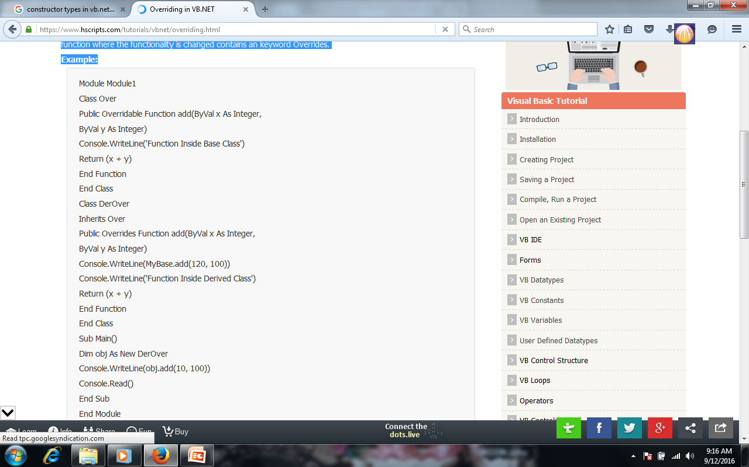
BY LECTURER SURAJ PANDEY CCT COLLEGE

Slide 36
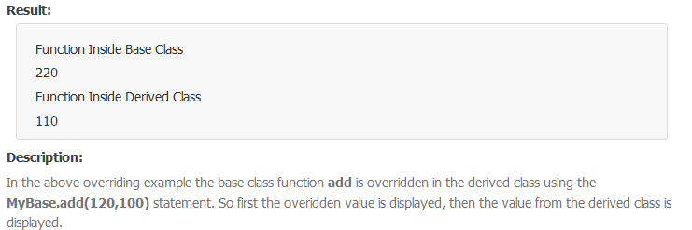
BY LECTURER SURAJ PANDEY CCT COLLEGE

Slide 37
Method Overloading and Method Overriding
What is method overloading?
When two or more methods (functions) in the same Class have the same name but different parameters is called method overloading.
Class myClass
{
int Func(int x)
{
}
int Func(string s)
{
}
int Func(int x,string s)
{
}
}
Here you can see the functions name are same but parameter type and number of parameters are different.

Slide 38
What is method Overriding?
When two or more methods (functions) have the exact same method name, return type, number of parameters, and types of parameters as the method in the parent class is called method Overriding.

Slide 39
class parentClass
{
public virtual void Disp(int i)
{
System.Console.WriteLine("parentClass Display" + i);
}
}
class childClass : parentClass
{
public override void Disp(int i)
{
System.Console.WriteLine("childClass Display" + i);
}
}
Here you can see the method name, parameter and return type are same but one method is in the parent class and another one in the child class.

Slide 40
Method Overloading
Method Overriding
Method overloading happens in the same class shares the same method name but each method should have different number of parameters or parameters having different types and order.
Method Overloading happens at compile time
In method overloading, method call to its definition has happens at compile time
In method Overloading, two or more methods shares the same name in the same class but having different signature
But in method overriding derived class have the same method with same name and exactly the same number and type of parameters and same return type as a parent class.
while Overriding happens at runtime.
while in method overriding, method call to its definition happens at runtime.
while in method overriding, method of parent class is re-defined in the inherited class having same signature.

Slide 41
In the case of performance, method overloading gives better performance when compared to overriding because the binding of overridden methods is being done at runtime.
Static binding is happens when method overloaded
Method overloading add or extend more to the method functionality
Static methods can be overloaded, that means a class can have more than one static method of same name.
It doesn’t provide better performance
while dynamic binding happens when method overriding.
while method overloading is to change the existing functionality of the method
But static methods cannot be overridden, even if you declare a same static method in derived class it has nothing to do with the same method of base class.

Slide 42
Overloading vs. Overriding
Don't confuse the concepts of overloading and overriding
Overloading deals with multiple methods in the same class with the same name but different signatures
Overriding deals with two methods, one in a parent class and one in a child class, that have the same signature

Slide 43
Abstract Classes and Methods
In the examples we've been using so far Person, Employee, and Customer have all been classes that can be created using the New operator.
However, there may be situations where a base class should never be created—perhaps there should only be instances of the Employee type and Customer type and never an instance of the Person type.
It's possible just to add a comment saying Person should never be created, or Person might have a Private constructor to make it impossible to create. However, Person can also be designated as an abstract type.
An abstract type is the same as a regular (or concrete) type in all respects except for one: An abstract type can never directly be created. In the following example, Person is now declared as an abstract type, using the MustInherit modifier.

Slide 44
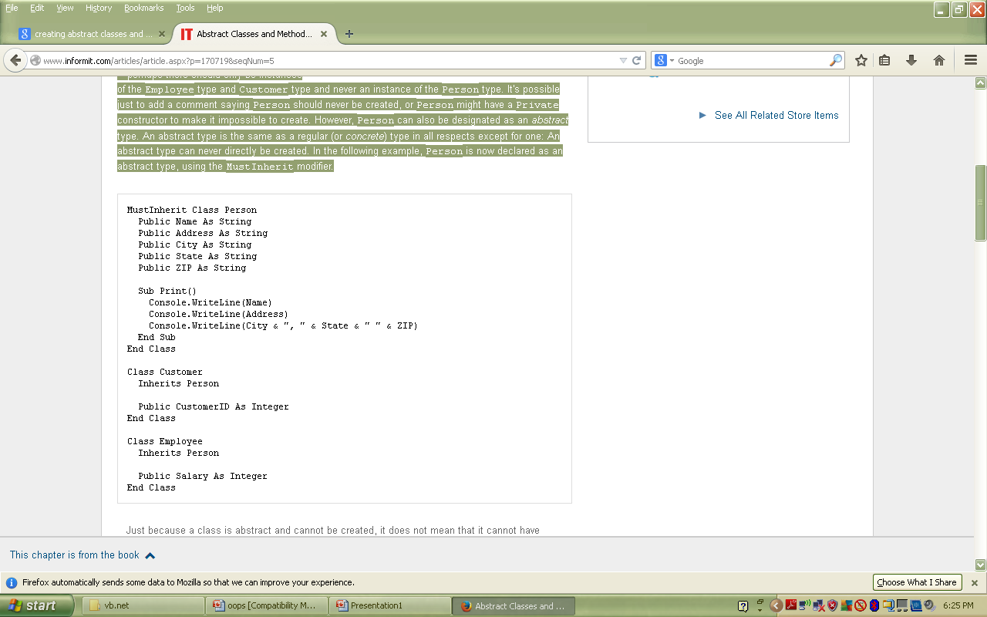

Slide 45
Abstract Classes in VB.net are classes that cannot be instantiated, but can implement any number of members. The Abstract Classes are declared using the keyword MustInherit. Overideable members should be declared inside the abstract class using the keyword MustOverride that are instantiated in the derived class by overriding them.
BY LECTURER SURAJ PANDEY CCT COLLEGE

Slide 46
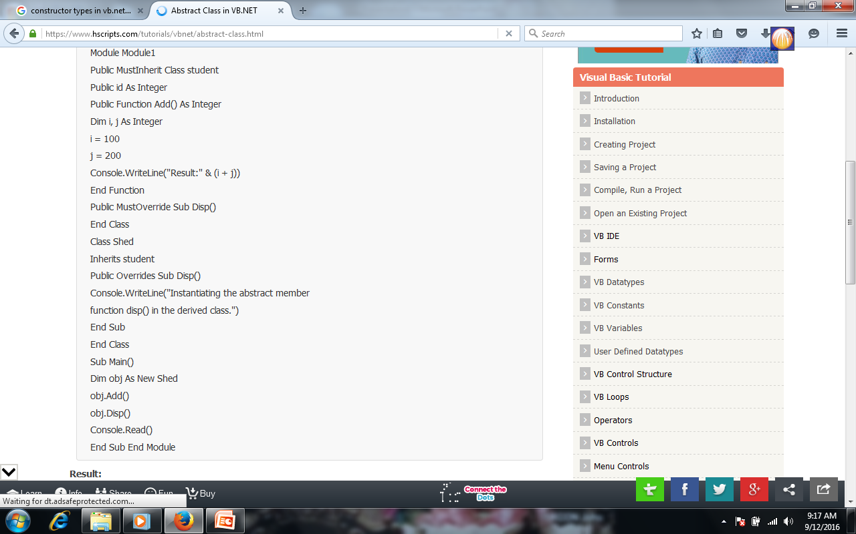
BY LECTURER SURAJ PANDEY CCT COLLEGE

Slide 47
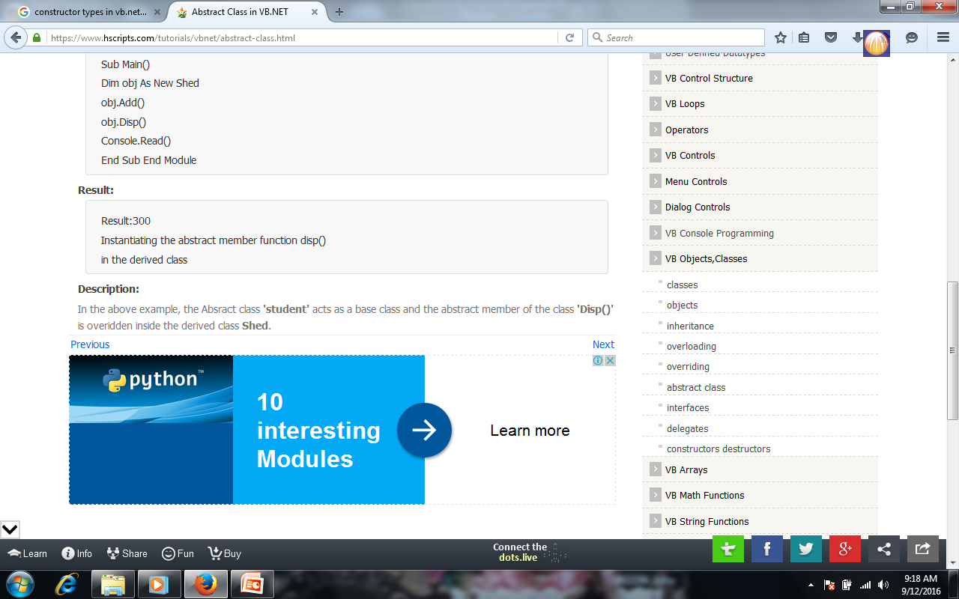
BY LECTURER SURAJ PANDEY CCT COLLEGE

Slide 48
Abstract classes are special in that they can also define abstract methods. Abstract methods are overridable methods that are declared with the MustOverride keyword and provide no implementation. A class that inherits from a class with abstract methods must provide an implementation for the abstract methods or must be abstract itself. For example, the Person class could define an abstract PrintName method that each derived class has to implement to display the person's name correctly.

Slide 49
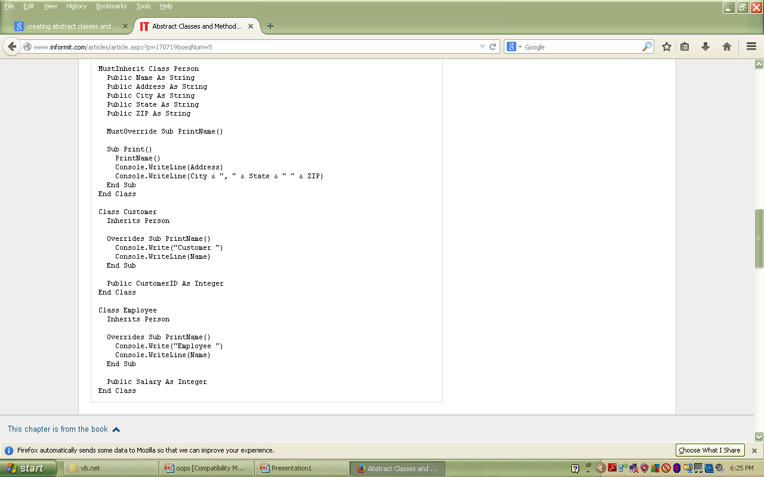

Slide 50
In this example, Person.Print can call the PrintName method, even though Person supplies no implementation for the method, because it is guaranteed that any derived class that can be instanced must provide an implementation.

Slide 51
Interfaces in VB.net are used to define the class members using a keyword Interface, without actually specifying how it should be implemented in a Class. Intefaces are examples for multiple Inheritance and are implemented in the classes using the keyword Implements that is used before any Dim statement in a class. Example:
BY LECTURER SURAJ PANDEY CCT COLLEGE

Slide 52
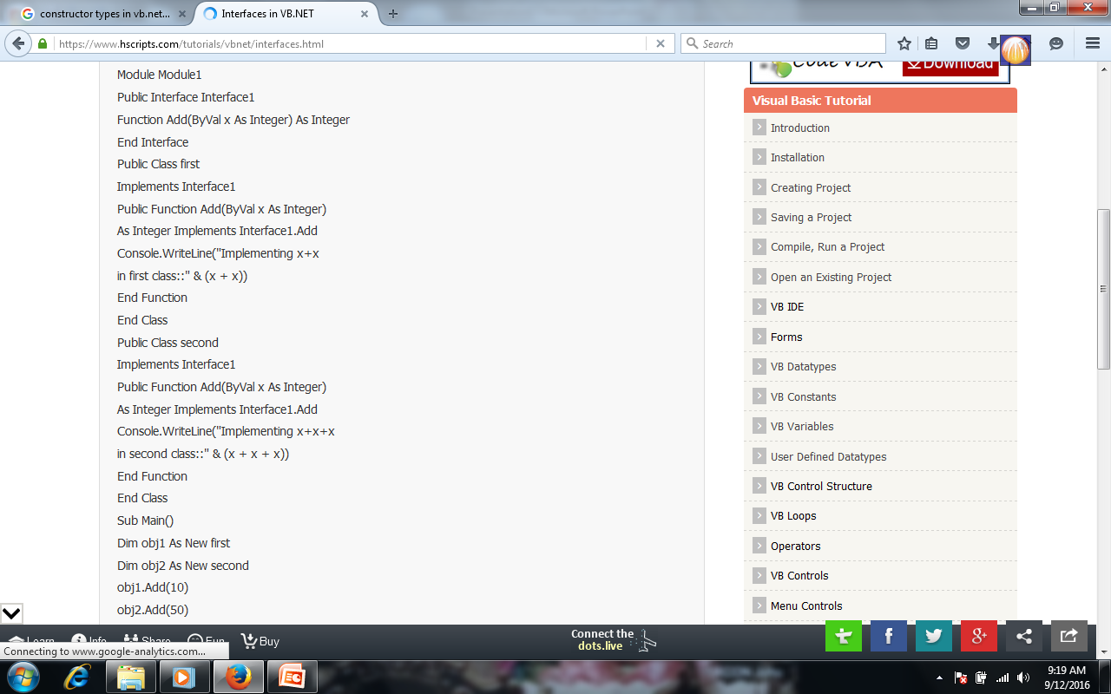
BY LECTURER SURAJ PANDEY CCT COLLEGE

Slide 53
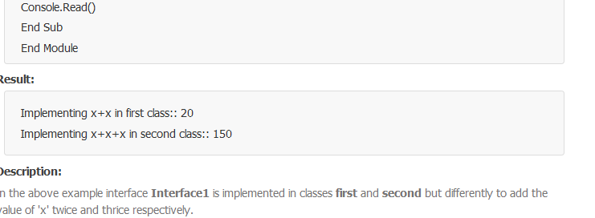
BY LECTURER SURAJ PANDEY CCT COLLEGE

